Slide 1

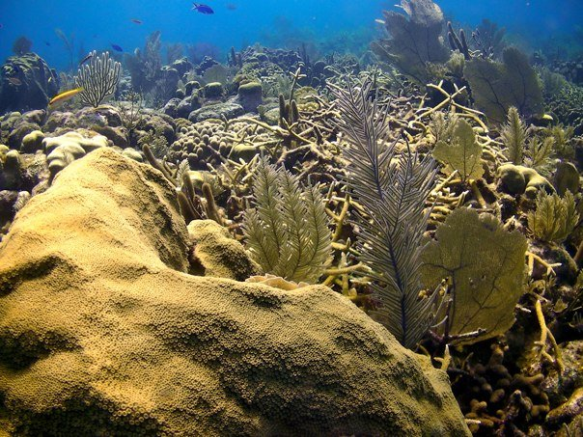
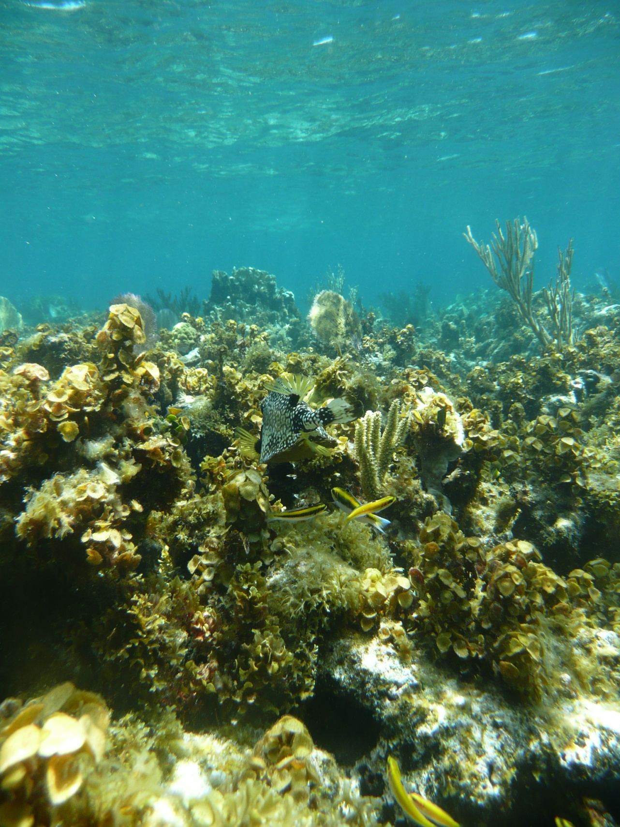
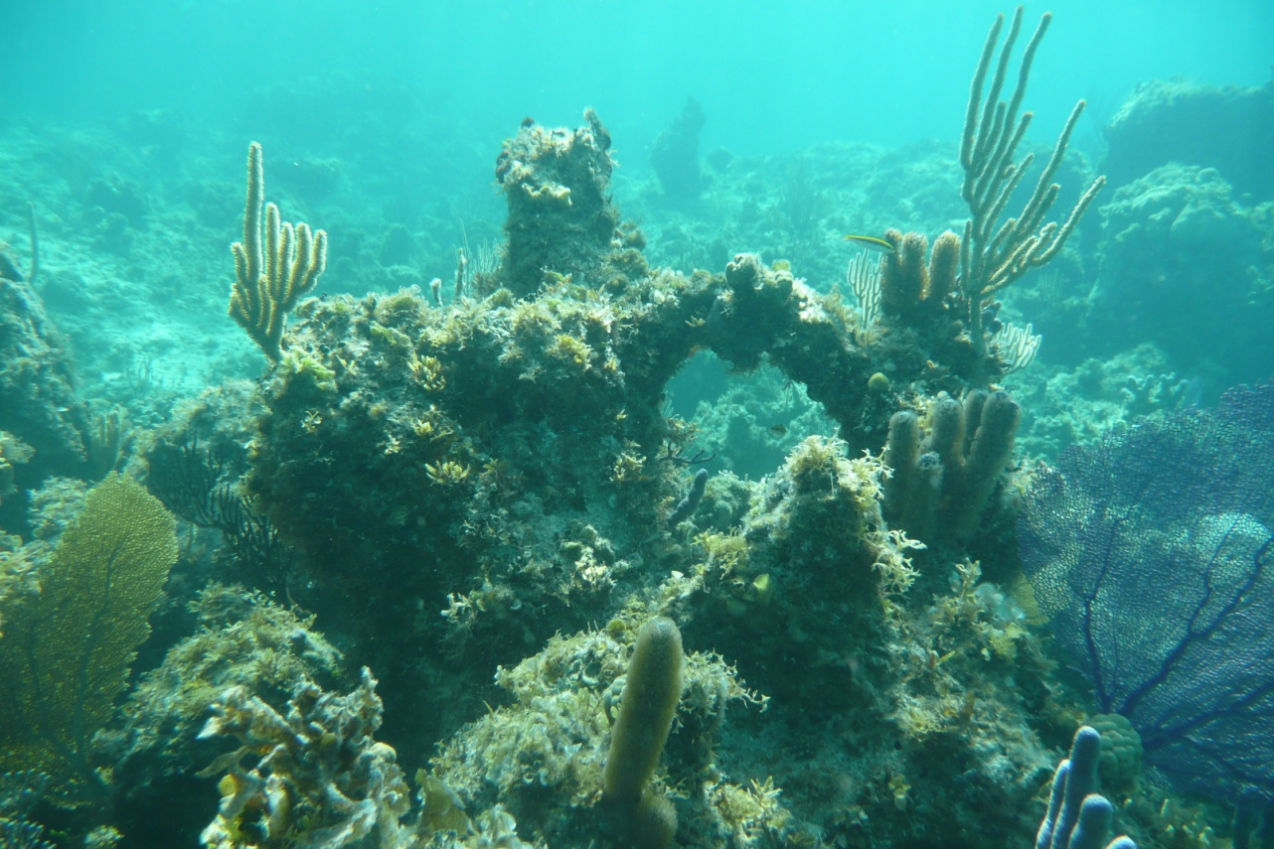
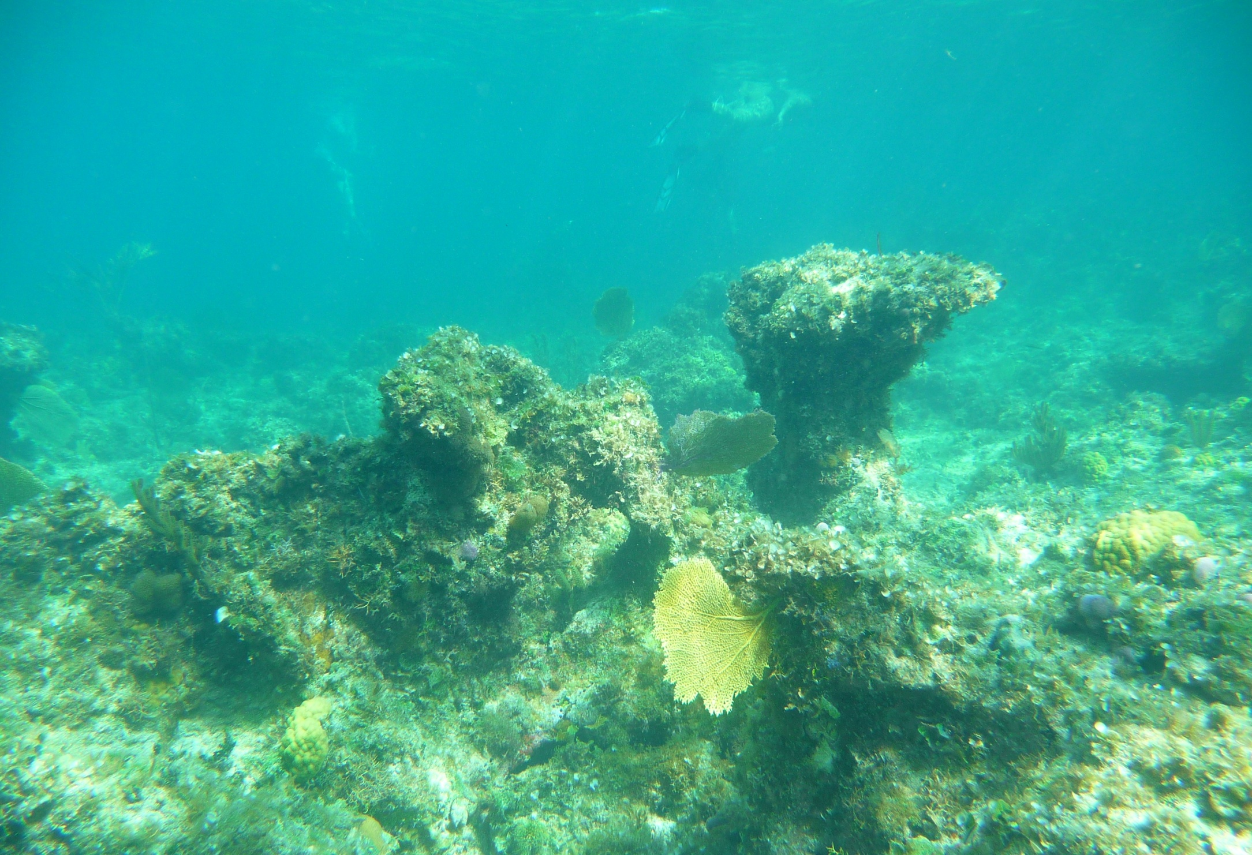

Balancing the carbonate budget:
maintenance of positive framework growth
in the Caribbean requires local and global action
Emma V. Kennedy, Chris T. Perry, Paul R. Halloran, Roberto Iglesias-Prieto, Juan Pablo Carricart-Ganivet, Max Wisshak, Christine H. L. Schönberg, Armin Form, Maoz Fine, Peter J. Mumby

Slide 2

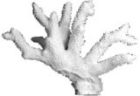
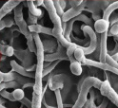

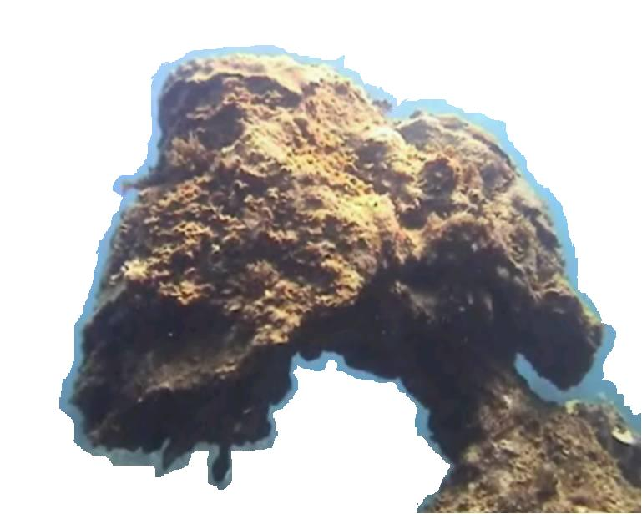
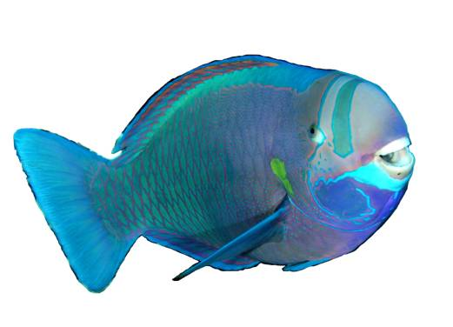

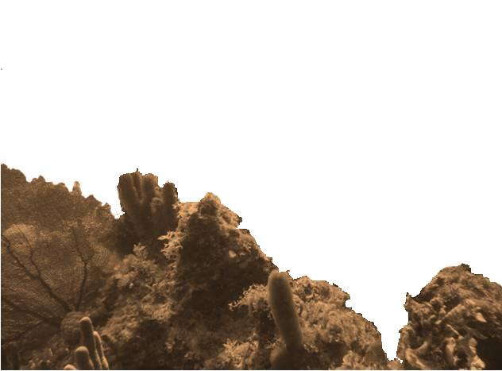
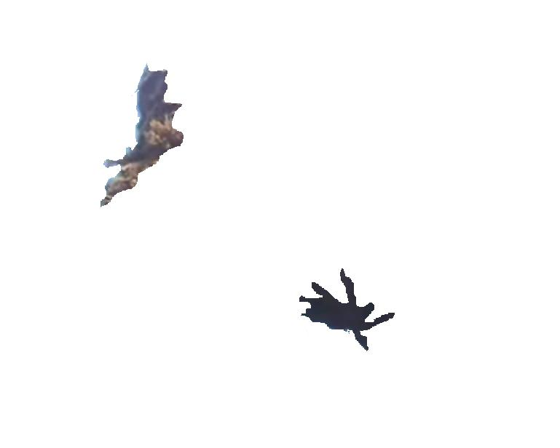
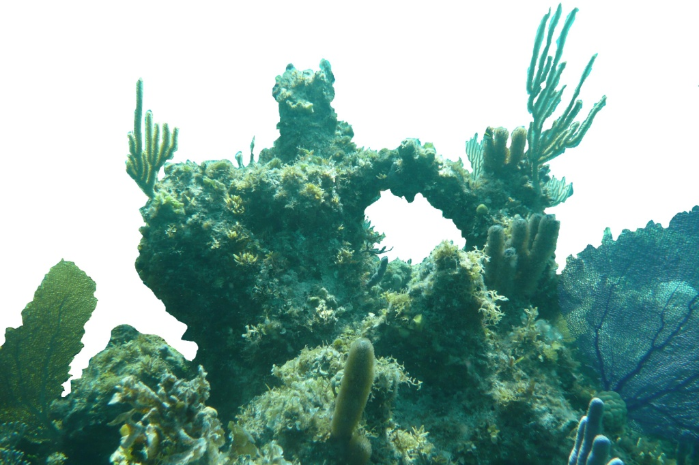

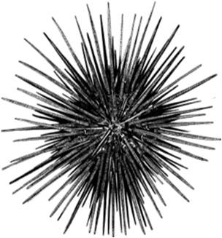
What is a carbonate budget?
Framework erosion
...a measure of the rate of accumulation of calcium carbonate reef framework
Framework production
Grazer erosion
(i.e. fish and urchins)
Microborer erosion
(algae, fungi, bacteria)
Macroborer erosion
(sponges, worms, bivalves)
Physical erosion
-2
5
Primary production
(i.e. scleractinian corals)
Secondary production
(e.g. CCA; encrusters)
Sediment
-1
1
SCARID
(grazer)
-1
1
-1
CLIONAID
(boring sponge)
AGARICIA
(primary producer)
DIADEMA
(grazer)
SIPUNCULID
POLYCHAETES
LITHOPHAGA
(bivalve)
CCA
(calcifying encruster)
SIPHONODICTYON
(boring sponge)
Kg CaCO₃ m⁻² year ⁻¹
Notes:
What is a carbonate budget? Ultimately a calcium carbonate budget is a TOOL that provies the measure of the rate the accumulation of reef framework, but also gives a lot of information on the functioning of a reef in terms of bioerosion and accretion. Framework is a dynamic entity: it is continuously being built up and broken down by a range natural processes. A carbonate budget simply attempts to quantify the accretory and erosional processes of framework construction, to ultimately provide an estimate of the RATE of accumulation of framework.
Estimation of a reefs carbonate budget is a holistic approach to measuring reef health – as it looks at this looks at the functioning of bioeroding organisms burrowing within the reef framework as well as more obvious coral cover and growth.
The components of a carbonate budget are generally measured in units of kg of calcium carbonate per planer m2 area of reef per year. They are summed to give a measure of net accretion of framework – in this case it would be 2 kg of CaCO3 per planar area of reef per year.
The resultant net rate of carbonate accumulation is a quantitative measure of the functional status or ‘health’ of a reef in terms of its ability to add carbonate to, or to maintain, its structural integrity - effectively determining whether a reef exists in a state of net accumulation, stasis or erosion. The relative roles of these crucial carbonate cycling processes are, however, rarely considered in existing reef health assessments and standardized approaches to quantifying carbonate budgets do not exist.
Carbonate budget is a measure of the rate of accumulation of reef framework. And hopefully we’re going to hear a bit more from Chris today about how these things can be measured in the field – but
Grazers.. Including urchins… and parrotfish
Microborers – algae, bacteria and fungi
Unfortunately, carbonate budgets are quite difficult to measure in the field and as a result only a handful of field budgets have been attempted.

Slide 3
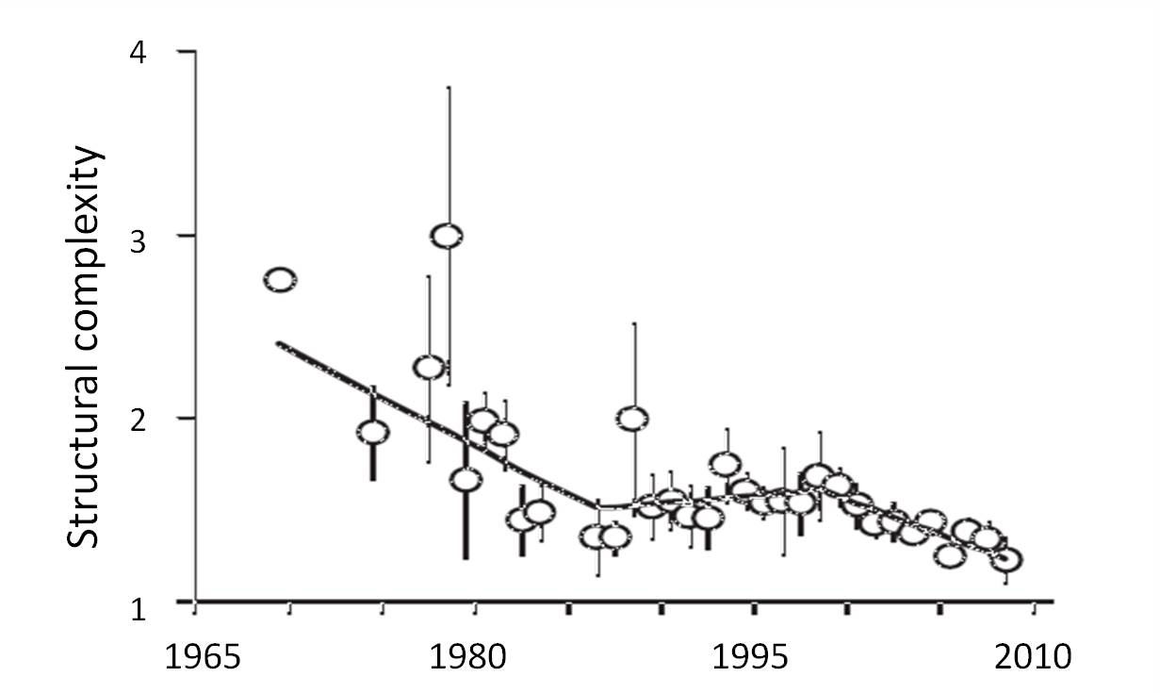
Why do we care?
1.
  Coral bleaching
  Ocean acidification
  Hurricane damage
  Algal blooms
  Coral disease
  Sedimentation
  Invasive species
  Diadema loss
Structure provides ecological goods and services
  Habitat (e.g. fishing valued at $US295 million)
  Coastal protection ($US 0.94-2.8 billion)
  Sand production ($US 2.7 billion)
Carbonate budgets
  Tool for assessment of reef health
  Beyond living coral cover/algal cover
Structural complexity
of Caribbean reefs
2.
FORCE project www.force-project.eu
Alvarez-Filip et al. 2009
Edinger et al. 2000. Marine Pollution Bulletin 40(5): 404-425.
Notes:
Why are we interested in carbonate budgets of Caribbean reefs?
The ecological state of Caribbean reefs has deteriorated over the last 50 years.
We’re aware of the main proximate drivers of this changes, which have caused many reefs that once looked like...this, to look bottom panel.
One aspect of this deterioration is loss of architectural complexity... Reefs are essentially getting flatter
Structure is associated with various ecological goods and services.
Examining carbonate budgets can help us UNDERSTAND this loss of structure.
In addition, carbonate budgets are a provide a useful tool for understanding the healthy functioning of a reef. They are a holistic health measure, as they take into account important bioerosive processes occuring below the surface of the reef – and so go beyond traditional measures of reef health such as looking at living coral cover and algal cover at the surface.
Reef health is often assessed in terms of living coral or macroalgal cover.
Carbonate budgets provide an alternative reef health assessment tool

Slide 4
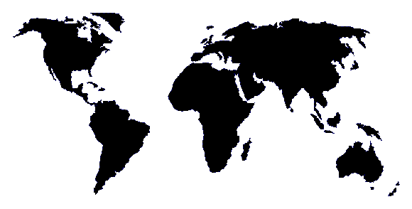
Why use modelling?
Few published attempts
No standardised methodology → a variety of approaches
ReefBudget (www.exeter.ac.uk/geography/reefbudget)
Real world carbonate budgets
+0.89
+1.10
Land, 1979
Harney & Fletcher, 2003
+9.52
Perry et al. 2012
+1.24
Mallela &
Perry, 2007
-0.19
+4.20
+11.2
Stearn & Scoffin, 1977
Edinger et al. 2000
Eakin, 1996
+8.3
+0.91
Conand et al. 1997
Hubbard et al. 1990
Net accumulation of reef framework (in Kg CaCO₃ per m² per year)
How have budgets across the Caribbean been responding to drivers of reef change?
ReefBudget (Chris Perry and Gary Murphy)
Notes:
As you can imagine, measuring carbonate budgets in the field is time consuming and difficult, and as a result only a handful of attempts have been made.
On top of this, until last year when a standardised methodology was developed by Chris Perry and his team – approaches varied and so any real world budgets that were collected were often not directly comparable.
So we needed to use a modelling approach in order to try and fill in some of the gaps that existed in our knowledge of carbonate budgets. Before the reef budget protocol was published.
‘rapid’ census-based methodology, termed ReefBudget
CLICK. There are different approaches to measuring a carbonate budget depending on whether you are a geologist, a chemist or a biologist. As ecologists, we are most interested in the net accumulation of framework as this may give us an idea about whether Caribbean reefs are growing or disappearing. Net accretion value may be positive, OR negative if erosion exceeds gross production.
As you can imagine, calculating a real world carbonate budget in the field is an incredibly time consuming a tricky process, as a result, only a handful of full carbonate budgets have been attempted. You can see calculated values for net framework accretion vary from -3 kg/m2/year to +11. Although Chris Perry and Gary Murphy who are both here today have been working hard to change this – looking forward to hearing more about that this afternoon.
In the Caribbean, values seem to be around 1-4kg/m2/year. Differences in the values may have been caused by different approaches to measuring the budget, inclusion or exclusion of certain processes, or genuine differences between the reefs or the state of the environment at the time. There have been very few budgets repeated.

Slide 5
Questions:
Q1. Have Caribbean carbonate budgets responded (if at all) to ecological disturbance over the last 50 years?
Q2. Which factors are important in driving carbonate budget changes?
Q3. At what point does a reef switch from phases of net carbonate production to net destruction?
Notes:
Given the lack of real world studies done, had several questions we wanted to address.
Firstly, we wanted to know if carbonate budgets are sensitive to those proximate drivers listed on the previous slide.
Secondly, if they are, we wanted to idenify factors important in determining budgets
Finally, the question that really drove my phd: at what point are we going to lose reef structure and all it’s associated benefits.
CLICK. 1. What effect have the proximate drivers skipped over on the first slide had on carbonate budgets, if any? The Caribbean has seen many changes over the past half century, but we don’t have much of an idea of how carbonate budgets have been affected, if at all. Because few real world carbonate budget studies have revisited the same site over long time series, we have no other way of testing this except for by modelling.
CLICK. 2: Modelling has proved incredibly useful in identifying important processes in ecology, where a lot of complex factors are playing a role. An example of this is Pete Mumby’s discovery that parrotfish are important in reef resiliance. Identifying processes or factors that are more important has real world implications for management of reefs.
CLICK. We finally wanted to ask the more general question: at what point does a reef switch from net accretion to net erosion? i.e. at what point are we going to start losing Caribbean reef framework and its associated ecological benefits, such as enhanced biodiversity and coastal protection? Really drove my phd. Posed to me by my supervisor.

Slide 6
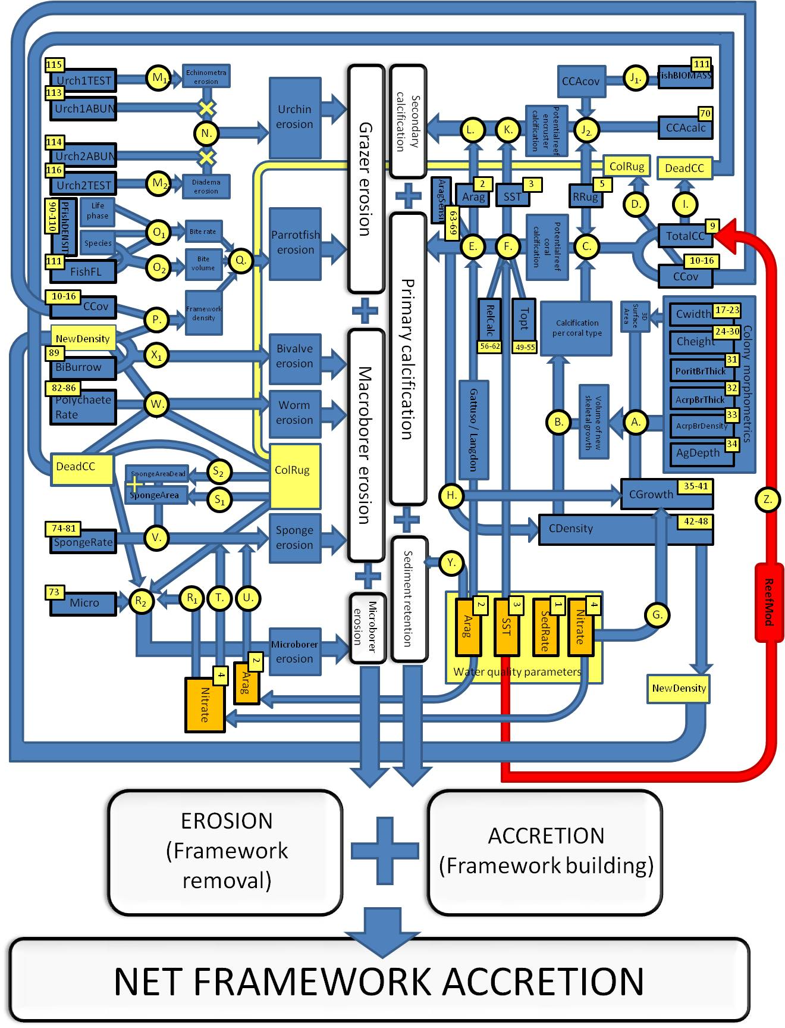
Carbonate Budget Model
Takes 116 input parameters (e.g. urchin test size, coral cover, SST)
Processes (e.g. effect of SST on coral calcification, polychate burrowing rate) derived from published work
Output: framework accretion/erosion rate (kg CaCO₃ m⁻² year⁻¹)
Input
Process
Output
Data flow diagram representing
carbonate budget algorithm
Notes:
Model parameters were gathered from We built a theoretical model, parameterised using published values. Summarise the main outline of the model: this is a simplification! Based on literally years of painstaking work by other. Values for mean, range and standard deviation took from past text.An extensive literature review helped us gather values for the different paramaters for each of these scenarios. Both mean values and standard deviations were collected so that values could vary randomly. Once these had been collected, we could begin construction of the model.
Get an idea of how many factors are interrelated.
‘Inputs’ are the bold blue boxes with yellow numbers = reef parameters. These are variables such as mean urchin test size, or coral cover or coral type – average values for Caribbean reefs were taken, and allowed to vary. The model can be run multiple times, and each time inputs are randomly generated based on the standard deviation, producing slightly different outputs.
Yellow circles are major process operations = Arrows represent data flow.
White boxes = outputs, represent rates of carbonate erosion or accretion – that make up the components of the model. These are then summed to give
what we want to measure (CaCO3 budget components – things like rate of macroborer erosion, and , which can be summed to give overall net framework accretion, in kg/m2/year. LHS of diagram is erosion calculations (includes sponge erosion etc); RHS is accretion calculations (includes coral growth etc)
Inputs can be changed to assess the behaviour of different reefs – for example if you were a marine park manager you could input information on coral cover or , we can choose input parameters for a healthy reef, a typical reef in the 1970’s, or a reef with no urchins on it. Multiple simulations can be run and behaviour of reefs compared.

Slide 7
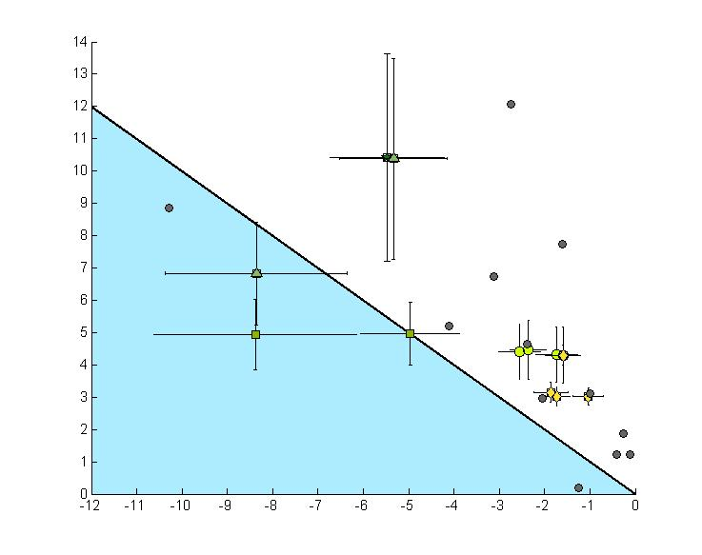
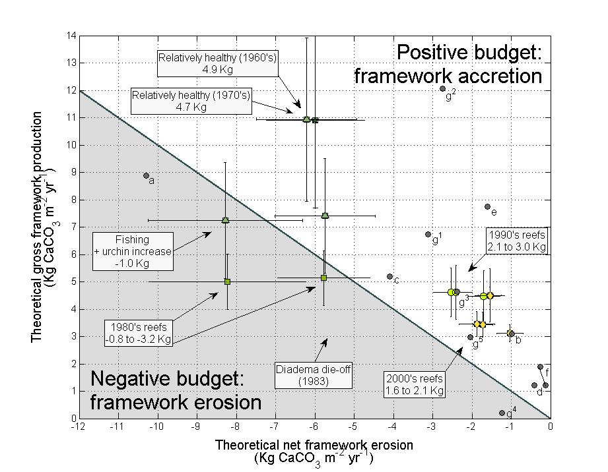
Q1. Historic changes in CaCO₃ budgets
Gross framework production
(Kg CaCO3 m⁻² year⁻¹)
Positive budget:
framework growth
Key
= 1960s
= “Healthly”
= 1970s
1960s
= Fished
= 1980s
1970s
= Polluted
= 1990s
= Polluted +
fished
= 2000s
1970s
Net framework erosion
(Kg CaCO3 m⁻² year⁻¹)
1.
2.
3.
4.
5.
1990s
1980s
2000’s
1960’s
1970’s
1980’s
1990’s
2000s
Threshold
Negative budget:
framework loss
Key |  | 1970s | 1980s | 1990s | 2000s
 |  | polluted | fished | polluted + fished | Published studies
Scenario |  | Era | Carbonate budget (Kg CaCO₃ m⁻² yr⁻¹) and reef scenario description |  | Coral Cover (%) | Urchins* | Acropora* | Parrotfish* | Nutrient (µM NO₃⁻) | Dominant coral*
Historical scenarios | 1 | 1960s | 5.0 | Relatively healthy ecosystem | 55 | + | + | + | 0.2 | Ac
 | 2a | 1970s | 5.0 | Healthy ecosystem + 10 years climatic change | 55 | + | + | + | 0.2 | Ac
 | 2b |  | -1.5 | Healthy ecosystem + heavily fished | 55 | ++ | + | - | 0.2 | Ac
 | 3a | early 1980s | -0.0 | Acropora loss+ lightly fished | 30 | + | - | + | 0.2 | Mo
 | 3b |  | -3.5 | Acropora loss + heavily fished | 30 | ++ | - | - | 0.2 | Mo
 | 4a | mid 1980s and 1990s | 2.1 | Diadema die-off + lightly fished | 25 | - | - | + | 0.2 | Mo
 | 4b |  | 2.7 | Diadema die-off + heavily fished | 25 | - | - | - | 0.2 | Mo
 | 4c |  | 1.9 | Diadema die-off + polluted | 25 | - | - | + | 0.4 | Mo
 | 4d |  | 2.6 | Diadema die-off + polluted and heavily fished | 25 | - | - | - | 0.4 | Mo
 | 5a | 2000s | 1.3 | Low coral cover + lightly fished | 10 | - | - | + | 0.2 | Mo
 | 5b |  | 2.0 | Low coral cover + heavily fished | 10 | - | - | - | 0.2 | Mo
 | 5c |  | 1.3 | Low coral cover + polluted | 10 | - | - | + | 0.4 | Mo
 | 5d |  | 2.0 | Low coral cover + polluted and heavily fished | 10 | - | - | - | 0.4 | Mo
Published studies | a | 1977 | 1.4 | Barbados, Bellairs Reef, fringing reef |  | Stearn & Scoffin, 1977
 | b | 1977 | 2.1 | Jamaica, fore reef terrace (15m) | n/a | Moore & Shedd, 1977
 | c | 1979 | 1.1 | Jamaica, Discovery Bay |  | Land, 1979
 | d | 1990 | 0.9 | St Croix, Cane Bay, fringing reef | 10-50 | Hubbard et al., 1990
 | e | 1996 | 6.2 | Bonaire, Karpata, reef slope (6-12m) | 31 | Bruggeman et al., 1996
 | f¹ | 2007 | 1.2 | Jamaica, Discovery Bay , clear water | 13 | Mallela & Perry, 2007
 | f² | 2007 | 1.9 | Jamaica, Discovery Bay, polluted fringing reef | 16 | Mallela & Perry, 2007
 | g¹ | 2012 | 3.6 | Bonaire, leeward fringing reef, MPA (5m) | 24 | Perry et al., 2012
 | g² | 2012 | 9.5 | Bonaire, leeward MPA (10m), high complexity | 28 | Perry et al., 2012
 | g³ | 2012 | 2.3 | Bonaire, leeward fringing reef (10m) | 25 | Perry et al., 2012
 | g⁴ | 2012 | -1.0 | Bonaire, windward fringing reef (5m) | 3 | Perry et al., 2012
 | g⁵ | 2012 | 1.0 | Bonaire, windward fringing reef (10m) | 17 | Perry et al., 2012
a
b
c
d
1
2a
Threshold
2b
3b
3a
4a
5c
4d
4b
4c
5b
5d
5a
Notes:
In order to address the first question, devloped a range of scenarios that represent reefs at various stages in time over the last 50 years. We wanted to see how various ecological events affected reef budgets. (We ran the model for a suite of historic scenarios, based on literature from various decadal time periods.)
Each scenario was run 250 times, and the results plotted on the graph
With Calcium carbonate production on the y-axis
And the sum of all the bioerosion components on the x
If reefs fell into this blue area, below the threshold line, erosion exceeds production and the carbonate budget is negative. Reefs falling into this area have posivitve budgets

Slide 8
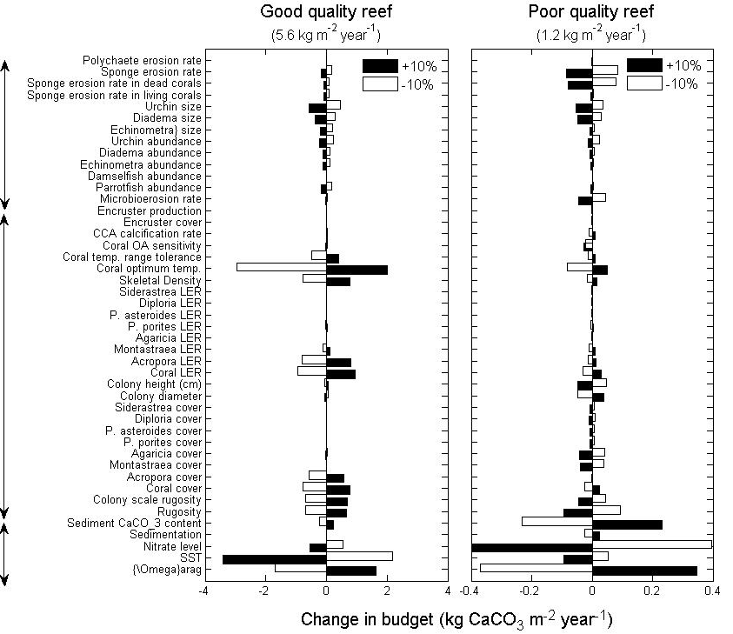
Q2. Sensitivity analysis
Bioerosion
Model parameters
Framework growth
Local environment
5.6
↑ SST → ↓ 68%
↑ Ω_{arag} → ↑ 27%
↑ Coral LER → ↑ 17%*
↑ Coral cover → ↑ 14%
↑ Coral skeletal density → ↑ 13%
1.2
↑ Nutrients → ↓ 68%
↑ Ω_{arag} → ↑ 53%
↑ SST → ↓ 18%
↑ Rugosity → ↓ 14%
↑ Sponge erosion → ↓ 11%
↑ Diadema size → ↓ 8%
Notes:
In order to compare the relative importance of the input factors on determining reef budget, we ran a sensivity analysis on the model. Instead of changing one factor, like increasing number of urchins to produce a plague, we sequentially took each of the 166 input parameters, and amended their value by 10% - noting the resulting effect of carbonate budget.
Interesting that water quality parameters – such as
Basically shows how responsive model is to each parameter. Bigger bars means that a small increase or decrease in the value of that parameter has a bigger effect on the model – implying that it’s more important in determining budget
Sensitivity of model to parameters
Sensitivity of modern reefs to Bar chart displaying the absolute change in carbonate budget output (x-axis) brought about by 10% change in variable (y-axis) value. Variables are grouped according to function. The model was tested using ‘healthy’ reef scenario (55% coral cover, high urchin and fish densities), which generates a reference budget of 5.6 kg CaCO₃ m⁻² year⁻¹ and a poor quality reef (10% coral cover, low diversity, few fish or urchins) accreting at 1.2 kg CaCO₃ m⁻² year⁻¹. Water quality parameters such as aragonite saturation state, SST and nitrate content remain important determinants of carbonate budget.

Slide 9
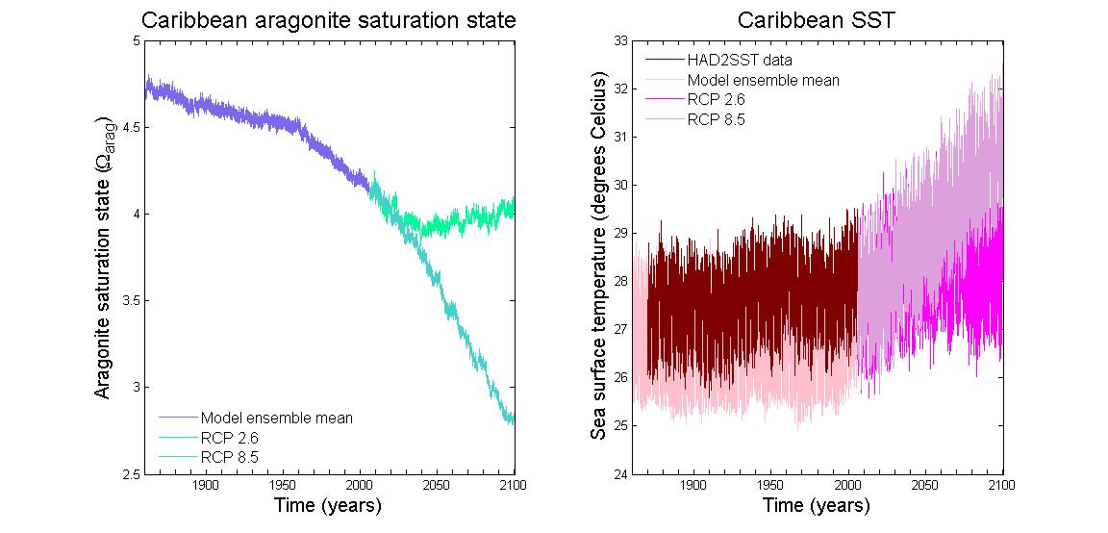
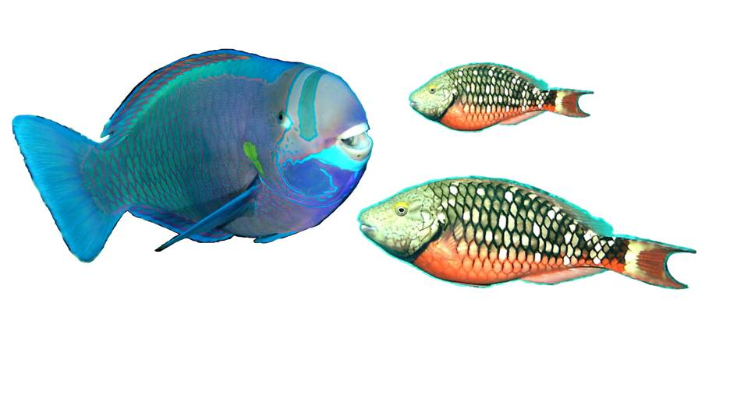
Q3. When will reef structure degrade?
Depends... Healthy vs Stressed
Local conservation action
  Positive effects of MPAs proven
  Local management approaches and MPAs alone will not halt biodiversity loss
  MPA vs fished reefs
Global climate change mitigation
  SST
  OA
RCP2.6
vs RCP8.5
Mumby & Harborne, 2010
Edwards et al. 2011
Mora & Sale, 2011
Riahi et al. (2007)
van Vuuren et al. 2007
Notes:
Representative Concentration Pathways – (RCP) 8.5 = 8.5W/m2 radiative forcing relative to pre-industrial levels

Slide 10
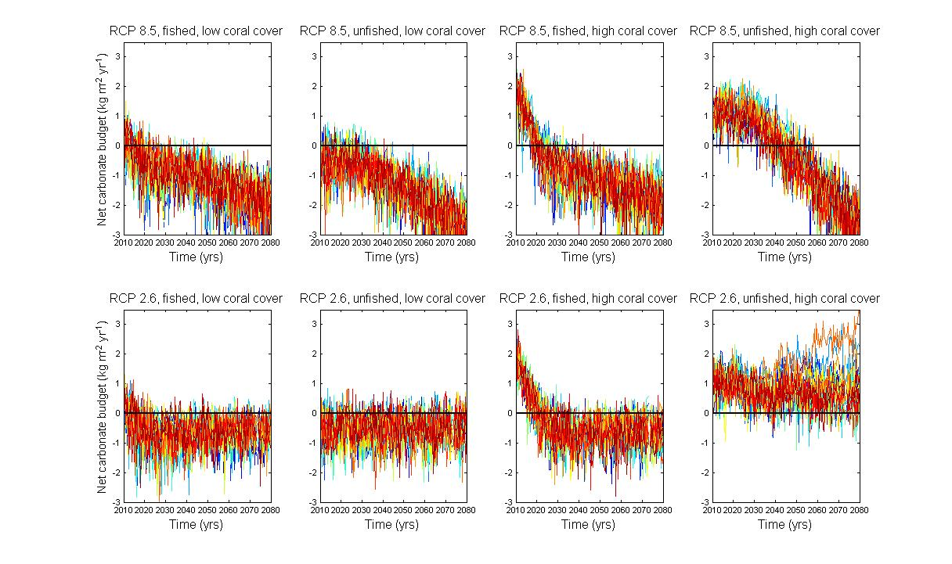
Carbonate Budget Projections
“Poor quality” reef
“Good quality” reef
☹
☹
☹
☹
‘Business as usual’
☹
☹
☹
‘Best case scenario’
☺
Notes:
Only where global CO2 mitigation and local management are combined does reef framework continue to accrete in the future
Main result: a series of plots displaying model carbonate budget outputs for eight future scenarios (L-R: S13-S6), from 2010 to 2080. The top panel shows outputs generated under pessimistic climate change scenarios (RCP8.5), and the bottom panel under climate mitigation (RCP2.6). The four panels on the left of the figure show the budget trajectory of a poor quality reef (10% coral cover, few fish and urchins), and the four panels on the right display outputs for a healthier reef (20% coral cover, diversity). Healthy and poor reefs under different climate scenarios were either ‘fished’ or ‘managed’ to explore the effects of local conservation on carbonate budgets. Each plot displays 20 simulations, with outputs generated at 6 monthly intervals. Only in the 8th panel, where fish were managed locally, and global climate mitigation scenario was used, do reefs continue to grow into the future.
- for 'poor reef' under RCP 8.5 (bad), local management has no bigger effect than no management (last time we couldn't explain why fishing IMPROVED the outlook of rubbish reefs under climate change, so this is better). Is this a good message though? Management appears to have little effect (in terms of carbonate budget) under the very worst case scenarios.
- local management now buys time on healthy reefs - about 30 years under RCP8.5(bad) and at least 60+ years under climate mitigation (RCP2.6).
- only reefs with local and global action survive into the future.

Slide 11
Conclusions
Q1. Are budgets sensitive to environmental change?
Q2. Which processes are important?
Q3. At what point does a reef switch?
Carbonate budgets appear to have responded to environmental perturbations over the last 50 years.
Events like the Diadema die-off have had large effects on reef budgets
Sea temperature and aragonite saturation state were identified as being important
Nutrients and bioerosion-associated processes increasingly influential in modern reefs
Both local and global action required to maintain positive reef growth until the end of the century.
Local conservation action may buy time

Slide 12









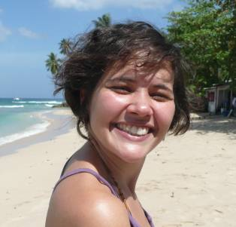





Thank you!
www.force-project.eu
For assistance with ICRS 2012 attendance...
Chris T. Perry – Exeter University
Paul R. Halloran – Met Office, UK
Gary Murphy – Exeter University, UK
Roberto Iglesias-Prieto – UNAM, Mexico
Juan Pablo Carricart-Ganivet – ECOSUR
Max Wisshak - Universität Erlangen-Nürnberg
Maoz Fine - Bar-Ilan University
Armin Form - IFM-GEOMAR
Christine H. L. Schönberg – AIMS, Australia
Mark Eakin – NOAA, USA
Iliana Chollett-Ordaz – Exeter University, UK
Jamie R. Stevens – Exeter University, UK
Peter J. Mumby – University of Queensland
E-mail: e.kennedy@exeter.ac.uk
Notes:
Thank you to University of Exeter and the FORCE project (www.force.eu) for supporting my project, to my collaborators (listed) and for everybody else that’s helped me. Also Fisheries Society of the British Isles, Society of Experimental Biology and ICRS for providing financial support to get me here. My email address if you have any comments or suggestions for me – fire away! Also I’m looking for a job in the spring**

Slide 13
Carbonate Budget Projections
“Poor quality” reef
“Good quality” reef
☹
☹
☹
☹
‘Business as usual’
☹
☹
☹
‘Best case scenario’
☺

Slide 14
Q1. Historic changes in CaCO₃ budgets
Gross framework production
(Kg CaCO3 m⁻² year⁻¹)
Positive budget:
framework growth
Key
= “Healthly”
1960s
= Fished
Bonaire,
2012
Threshold
1970s
= Polluted
Bonaire,
2012
= Polluted +
fished
Barbados,
1977
1970s
Net framework erosion
(Kg CaCO3 m⁻² year⁻¹)
Jamaica, 1979
1990s
Jamaica,
1977
1980s
Bonaire,
2012
Jamaica,
2007
Negative budget:
framework loss
St Croix,
1990
2000s
Bonaire,
2012

Slide 15
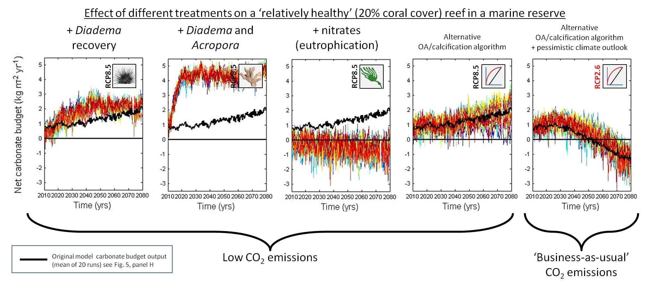
Wildcard plots

Slide 16
Validating the model: a Jamaican case-study
% cover
Time
Hurricane Allen
Diadema die-off
Hurricane Gilbert
Hurricane Allen
Diadema die-off
Hurricane Gilbert
5.2 kg
- 4.1 kg
Net carbonate accretion (kg m⁻² year⁻¹ )
1.23 kg CaCO₃
% cover
1.1 kg CaCO₃
Time
Liddell & Ohlhorst, 1992. 7th ISRS, Guam
Hughes, 1994. Science 265: 1547-1551
Time
Mallela & Perry, 2007. Coral Reefs 26(1):129-145
Land, 1979. Marine Geology 29(1-4):55-71

Slide 17
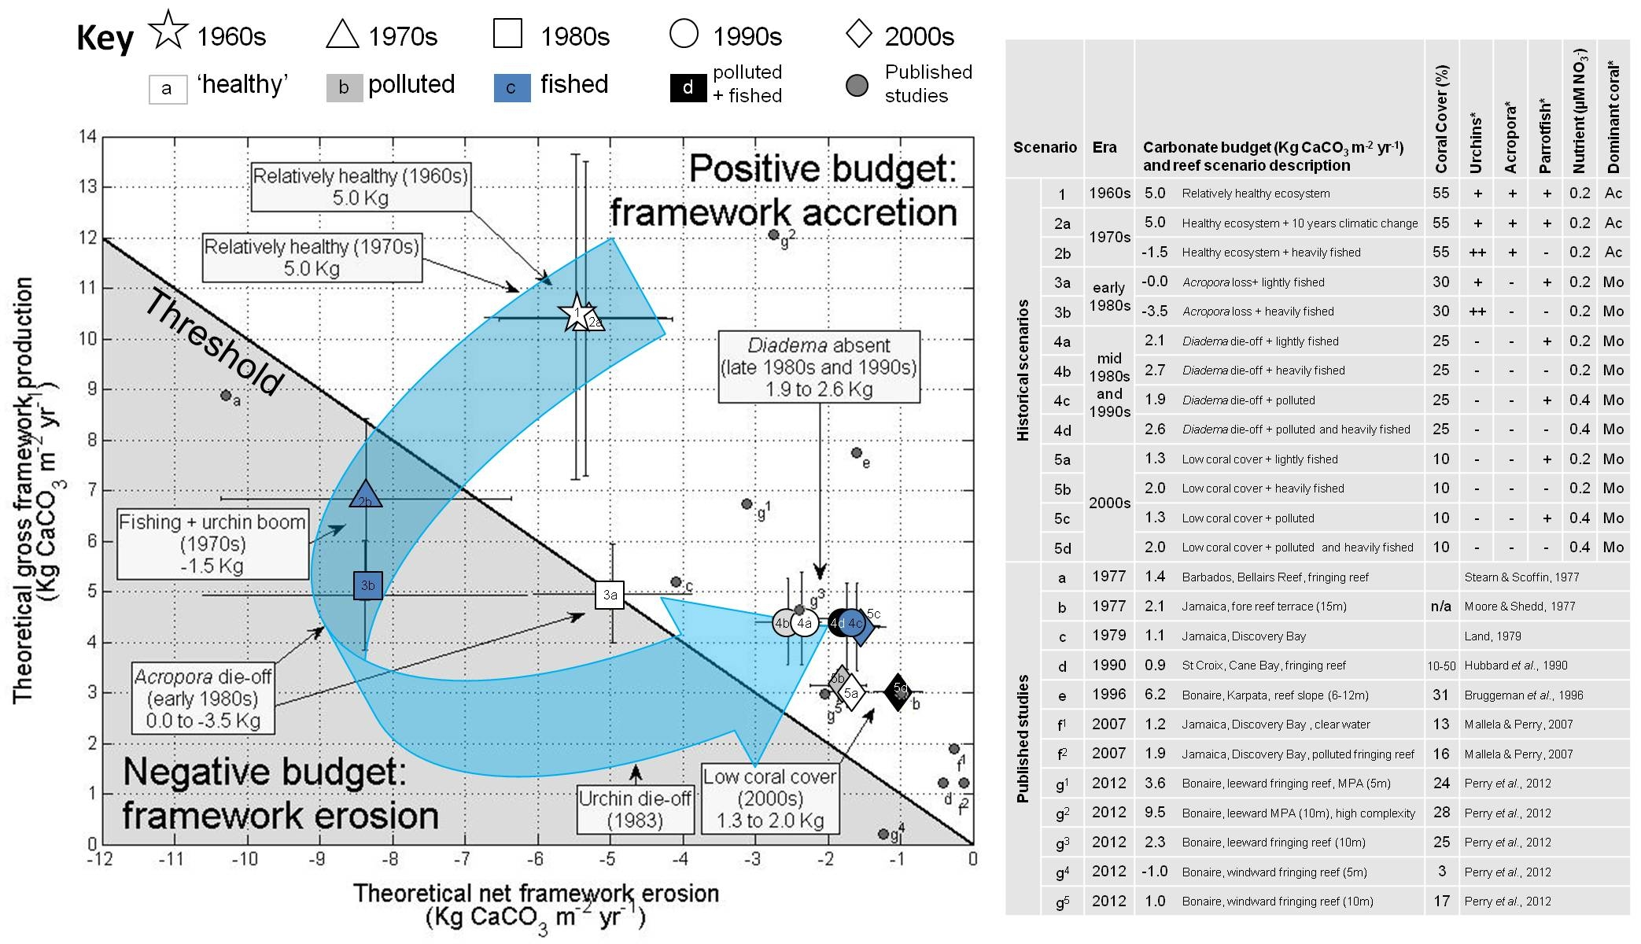
Q1. Historic changes in budget

Slide 18

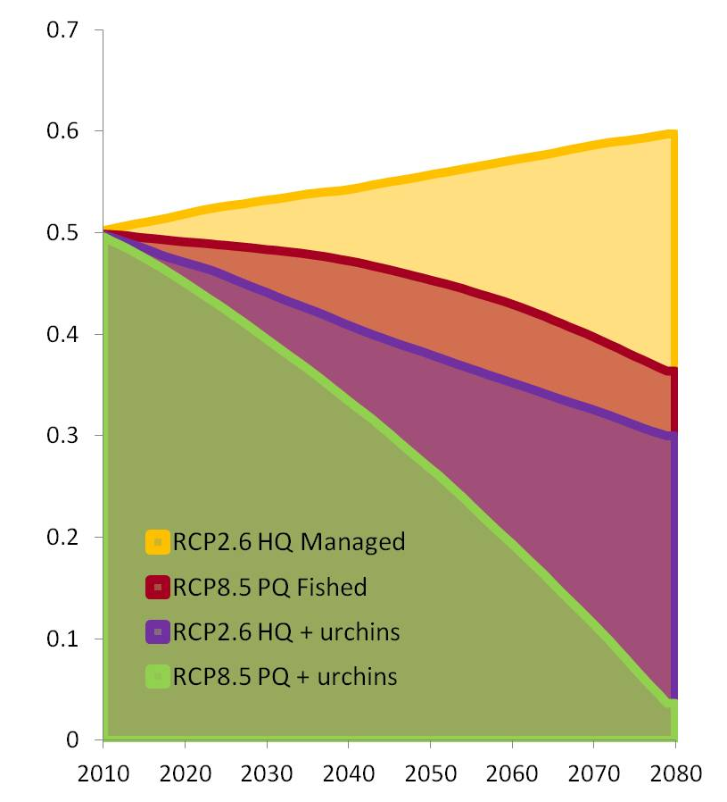
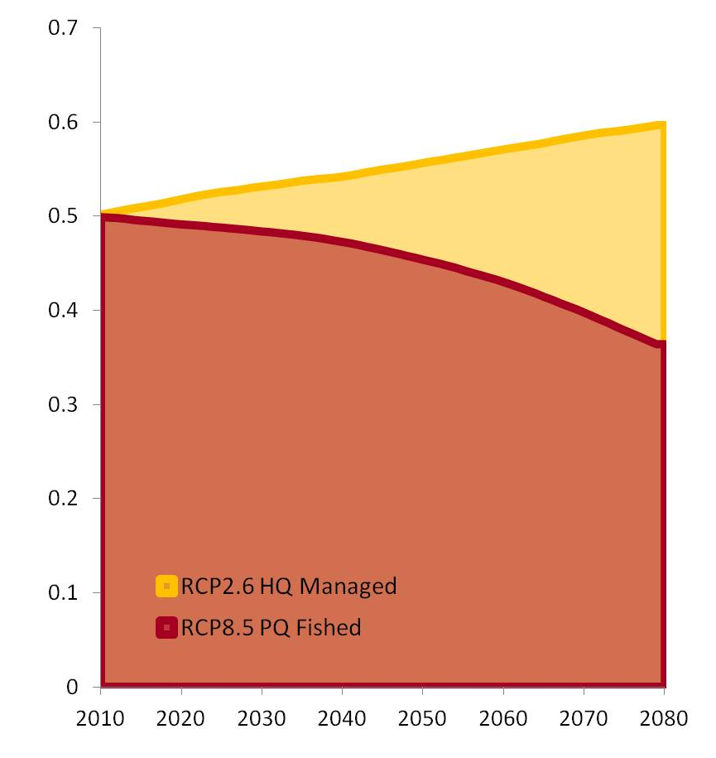
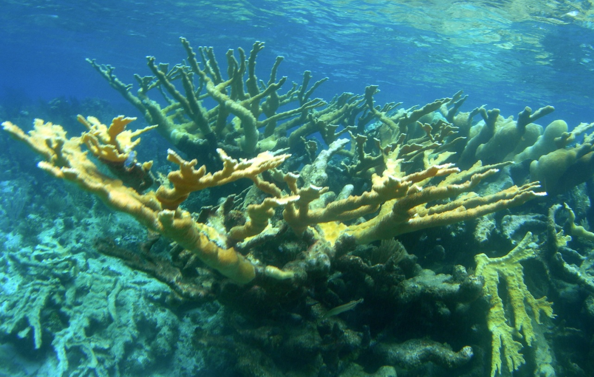
Vertical accretion
Depends on porosity (30%) and framework density (1.7)
Rates of removal up to 20 cm / 1000 years
2010 height
Urchins
Verticalaccretion (m)
Returning to Caribbean
Projection (year)
Notes:
Kg off a m2 block is the equivilent of shaving off between a mm and half a mm off a m2 block.
I guess erosion doesn't take place uniformly over the surface of the reef, so
biomass at the most pristine reefs being around 530 grams per
square meter. So if we round this down to 500 grams per square meter then

Slide 20
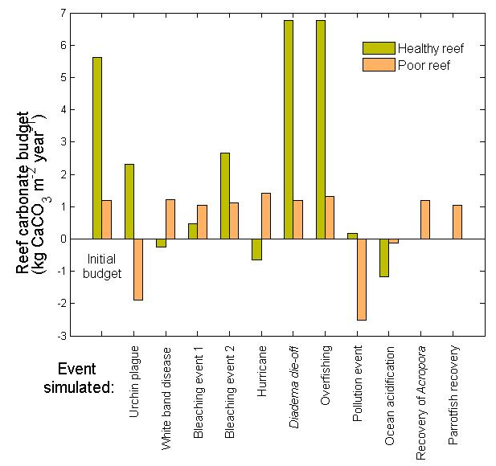
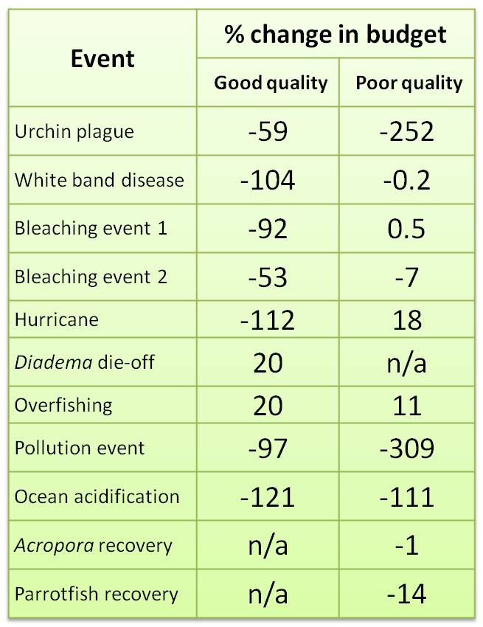
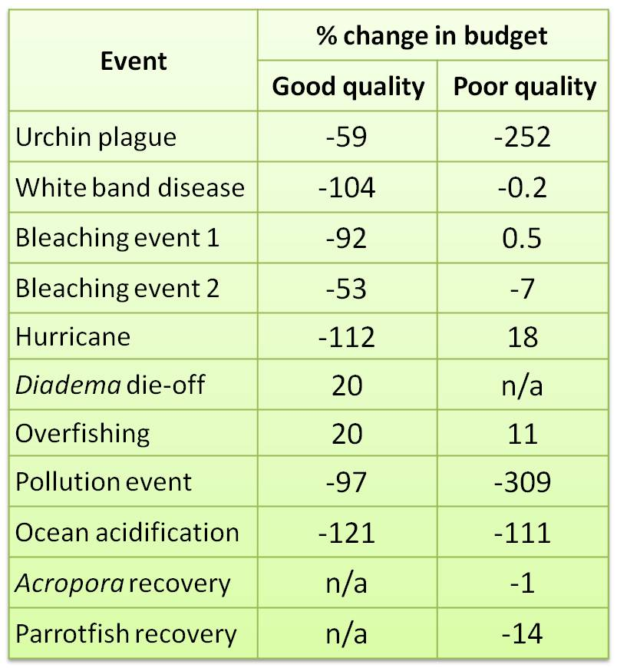
Q1. Simulated disturbance events
5.6
50% coral cover
Plentiful fish and urchins
Optimal conditions
1.2
10% coral cover
Fished, lacking urchins
Poor water quality
Hughes et al 1987, Hay 1984, Ogden 1977
Hughes 1989, Alvarez-Filip et al 2009
Hughes 1985, Lessios 1988
Mallela & Perry 2007, Carreiro-Silva et al 2005
Event | % change in budget
Urchin plague | -74
Bleaching event | -109
Hurricane | -76
Urchin-die-off | +40
Pollution event | -115
Event | % change in budget
 | Good quality | Poor quality
Urchin plague | -59 | -252
White band disease | -104 | -0.2
Bleaching event 1 | -92 | 0.5
Bleaching event 2 | -53 | -7
Hurricane | -112 | 18
Diadema die-off | 20 | n/a
Overfishing | 20 | 11
Pollution event | -97 | -309
Ocean acidification | -121 | -111
Acropora recovery | n/a | -1
Parrotfish recovery | n/a | -14

Slide 21
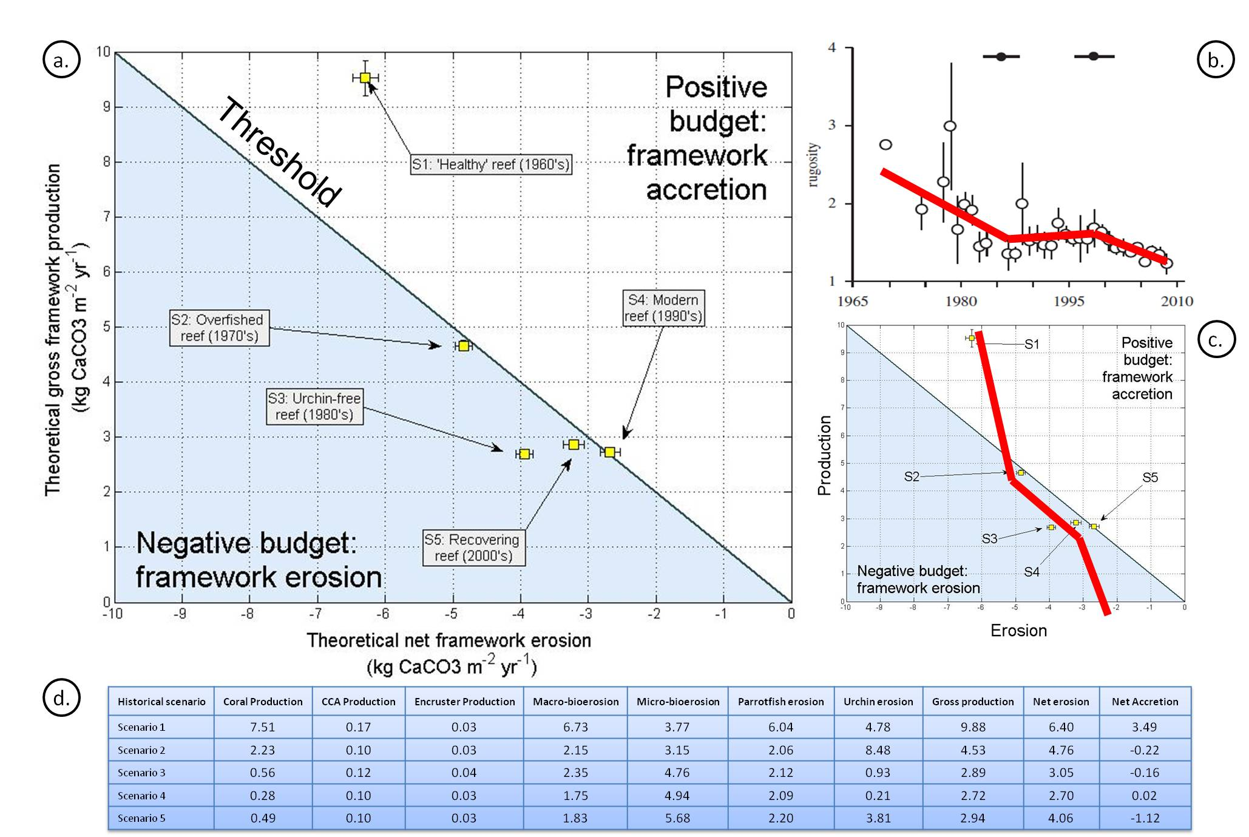
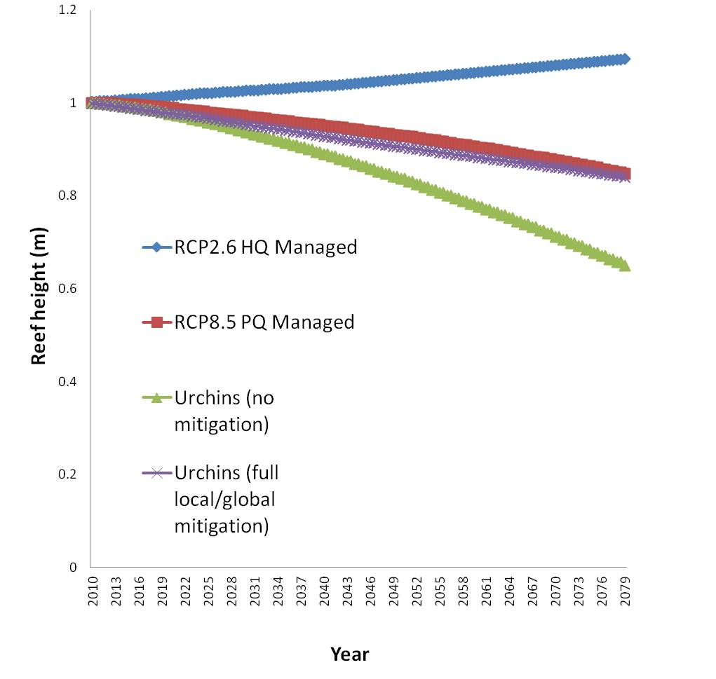
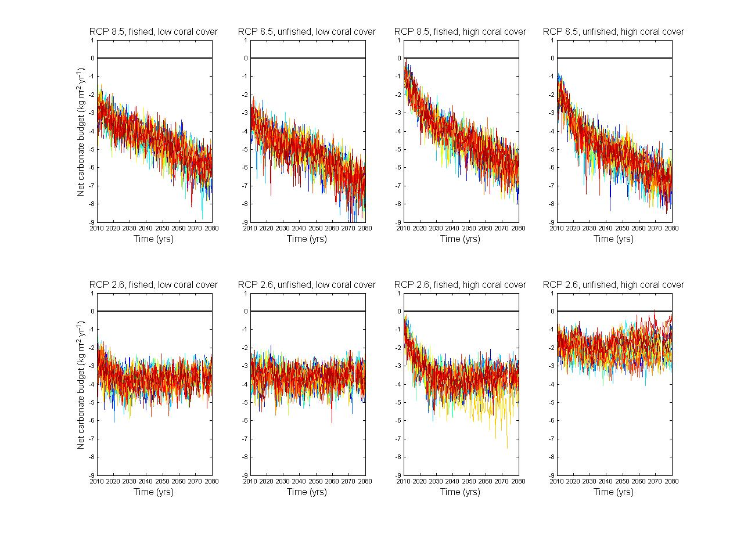
Urchins
Recent observations indicate presence of new colonies of A. palmata in many areas (e.g., St Croix, Jamaica, Puerto Rico³⁰⁻³²). Diadema sp. populations show similar widespread and sustained recovery^{33,34}. Urchin densities approaching those recorded prior to mass mortality events (e.g., 4.0±0.9 Diadema m⁻² and 2.3 Echinometra m⁻²) have been linked with reduction in macroalgal cover and increasing recruitment of juvenile coral³⁵ (and therefore Acropora restoration). S5 was designed to provide a positive outlook for Caribbean reefs, allowing for reef recuperation, with contribution of Acropora to the live coral community increasing from 0.8% to 30% (accompanied by a living coral cover of 20%), and a conservative estimate Diadema increase to one urchin m⁻².
Despite recovering coral almost doubling carbonate production to 0.49±0.25 kg, the ten-fold increase in Diadema abundance generates a 20-fold increase in urchin erosion capability, producing a mean negative carbonate budget (-1.1±1.3 kg CaCO₃ m⁻² year⁻¹). Increasing coral cover in a step-wise fashion revealed that 1 ind. m⁻² Diadema density needs to be accompanied by a >46% increase in coral cover in order for a positive budget to be maintained, suggesting that effects of restoration of these powerful grazing bioeroders – especially on poor quality reefs - may not have the positive impacts hoped for.
The effect of increasing Diadema numbers is severe, and results in a negative budget, even if climate mitigation or conservation action is implanted. On a healthy reef, where local and global conservation action has taken place, the resulting budget in will lose 136 kg of framework material per m2 over the next 70 years – that’s difference of 189.6 kg of reef (if Diadema numbers had not recovered the same reef would accumulate 80.2kg CaCO3 over the same time period) – and results in a loss of 16cm of framework. If no climate mitigation takes place and the reef is continually exploited, up to 35 cm of framework could be lost (298 kg CaCO3).
Notes:
Allows us to focus on particular aspects of the model – example in urchins.
Historically interesting, large crash in urchins the most important driver
History of Caribbean budgets very related to urchin activity – and coral cover
Urchins making a come back.

Slide 22
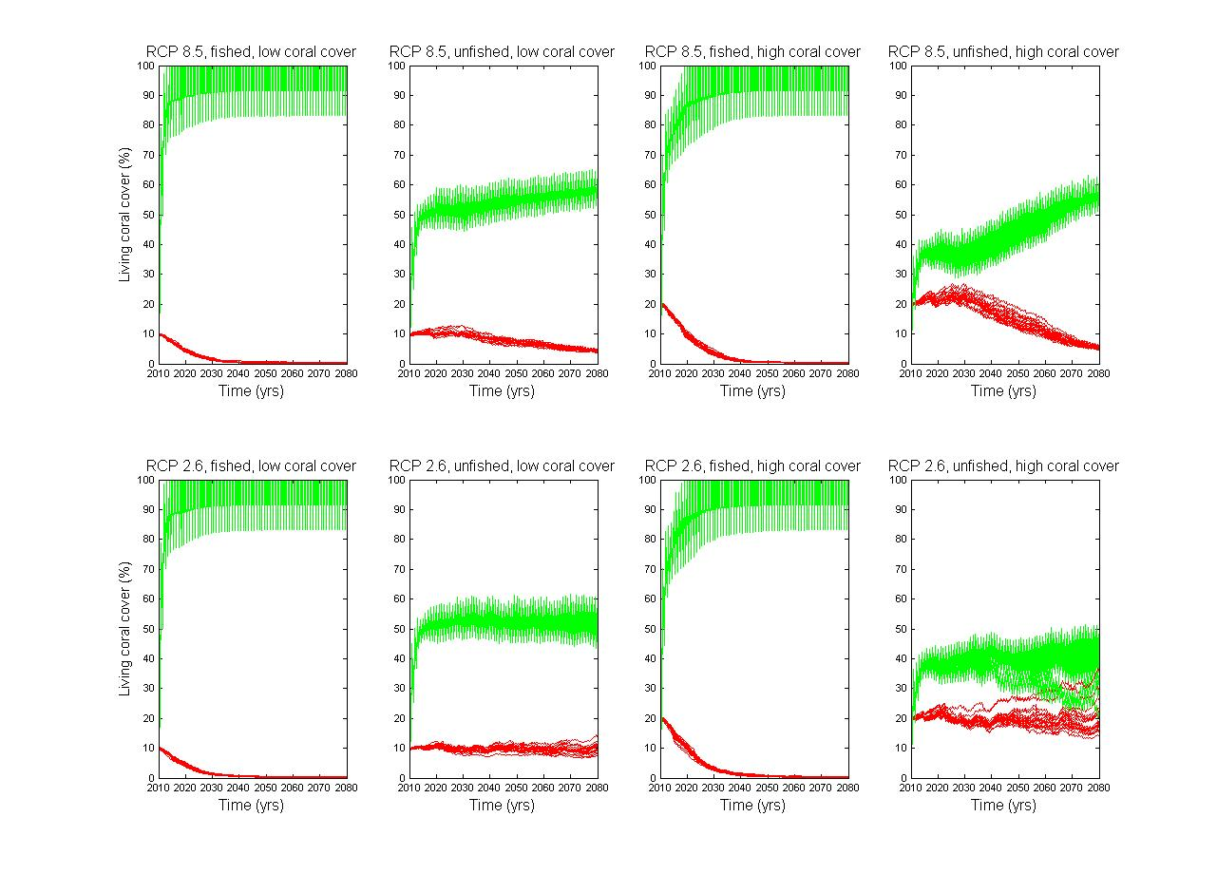
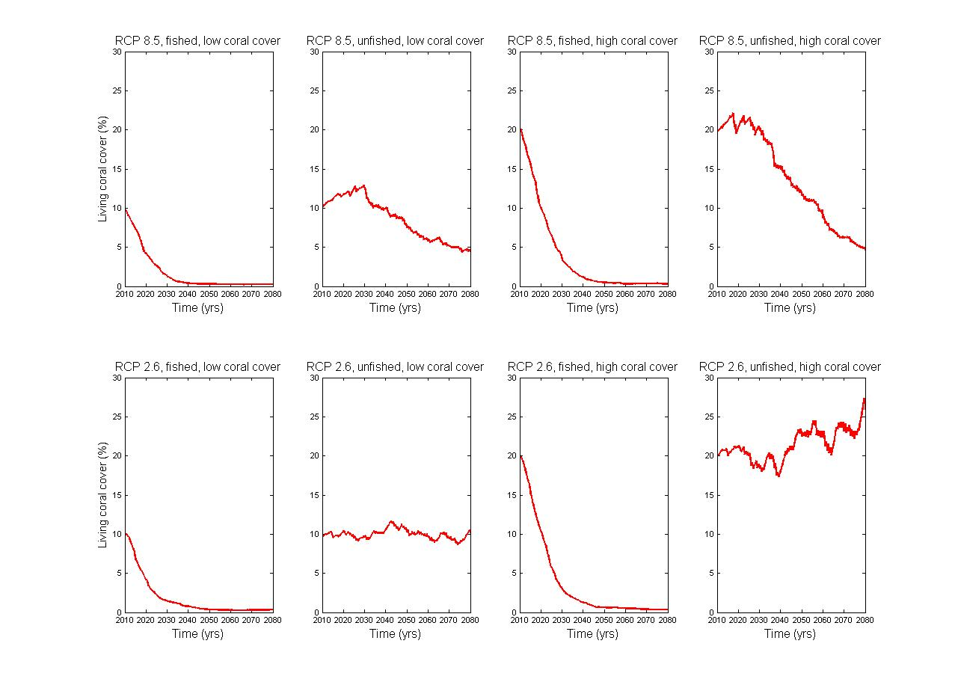

Slide 23
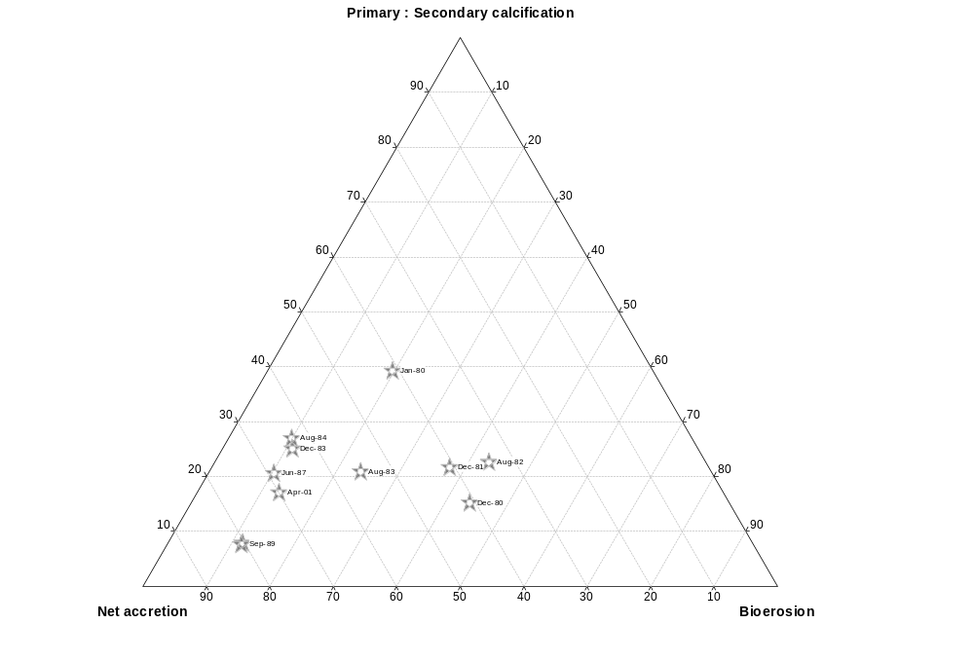
Primary CaCO3 production (coral)
+10
% cover
Net accretion (kg/m2/year)
+5
Year
1
+1
Jamaica: positive to negative
Stasis
Primary : Secondary calcification
-1
Net erosion (kg/m2/year)
- 1
-5
- 1
-10
Secondary CaCO3 production (CCA and encrusters)
Low (0)
Bioerosion (kg CaCO₃ m⁻² year⁻¹)
High (10)

Slide 24
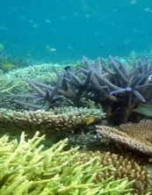
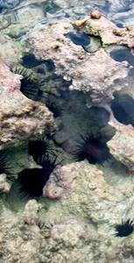

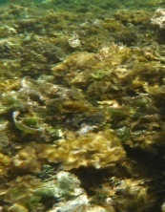
S1
S2
S3
S4
Healthy reef
1960’s – ‘70’s
Fished reef
1970’s – ‘80’s
Diadema-free reef
1980’s – ’90’s
Modern reef
1990’s – ’00’s
Negative budget:
framework erosion
-0.96 kg
2.54 kg
Theoretical net framework erosion (kg CaCO₃ m⁻² yr⁻¹)
-0.27 kg
0.54 kg
Positive budget:
framework accretion
Theoretical gross framework production (kg CaCO₃ m⁻² yr⁻¹)

Slide 25
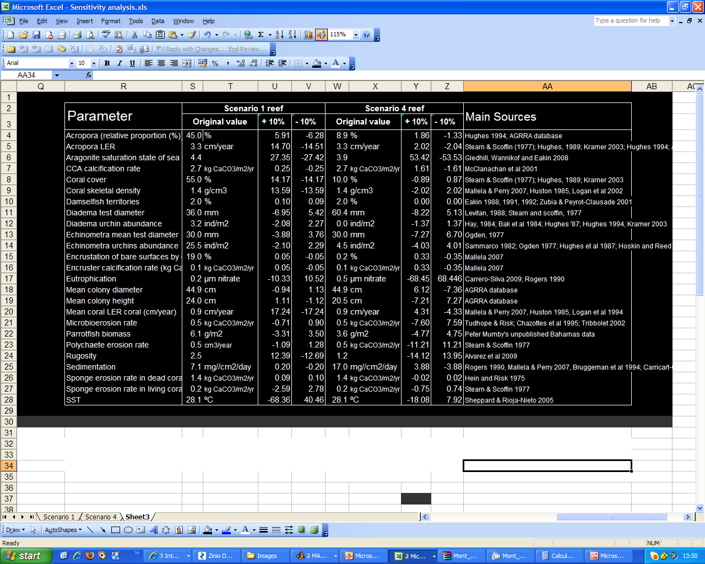
Effect of a 10% change in parameter value on a ‘healthy’ reef
Of the 180 main variables, which are the most important?
SST
Aragonite saturation state
Rugosity
Nutrient level
Sedimentation rate
Mean coral LER coral
Acropora LER
Coral cover
Coral skeletal density
Acropora (relative proportion)
Mean colony height
Mean colony diameter
CCA calcification rate
Encruster calcification rate
Encrustation of bare surfaces
Diadema diameter
Echinometra diameter
Parrotfish biomass
Echinometra abundance
Diadema abundance
Damselfish territories
Sponge erosion rate in living coral
Sponge erosion rate in substrate
Polychaete erosion rate
Microbioerosion rate
↑ SST → ↓ 68%
↑ Ω_{arag} → ↑ 27%
↑ Coral LER → ↑ 17%*
↑ Coral cover → ↑ 14%
↑ Coral skeletal density → ↑ 13%
% change in net carbonate accretion

Slide 26



Simulating the effect of major events on budget
Event | % change in budget | Actual change (in kg m⁻² yr⁻¹)
Urchin plague | -74 | -4.03
Bleaching event | -109 | -5.95
Hurricane | -76 | -4.15
Urchin-die-off | +40 | +2.16
Pollution event | -115 | -6.29
Hughes et al 1987, Hay 1984, Ogden 1977
Hughes 1989, Alvarez-Filip et al 2009
Hughes 1985, Lessios 1988
Mallela & Perry 2007, Carreiro-Silva et al 2005

Slide 27
S1 ‘healthy’ reef
S4 ‘modern’ reef
 | SST
 | Aragonite saturation state
 | Rugosity
 | Nutrient level
 | Sedimentation rate
 | Mean coral LER coral
 | Acropora LER
 | Coral cover
 | Coral skeletal density
 | Acropora (relative proportion)
 | Mean colony height
 | Mean colony diameter
 | CCA calcification rate
 | Encruster calcification rate
 | Encrustation of bare surfaces
 | Diadema diameter
 | Echinometra diameter
 | Parrotfish biomass
 | Echinometra abundance
 | Diadema abundance
 | Damselfish territories
 | Sponge erosion in coral
 | Sponge erosion rate in substrate
 | Polychaete erosion rate
 | Microbioerosion rate
Healthy reef results
↑ SST → ↓ 68%
↑ Ω_{arag} → ↑ 27%
↑ Coral LER → ↑ 17%*
↑ Coral cover → ↑ 14%
↑ Coral skeletal density → ↑ 13%
Modern reef results
↑ Nutrients → ↓ 68%
↑ Ω_{arag} → ↑ 53%
↑ SST → ↓ 18%
↑ Rugosity → ↓ 14%
↑ Sponge erosion → ↓ 11%
↑ Diadema size → ↓ 8%
% change in net carbonate accretion

Slide 28
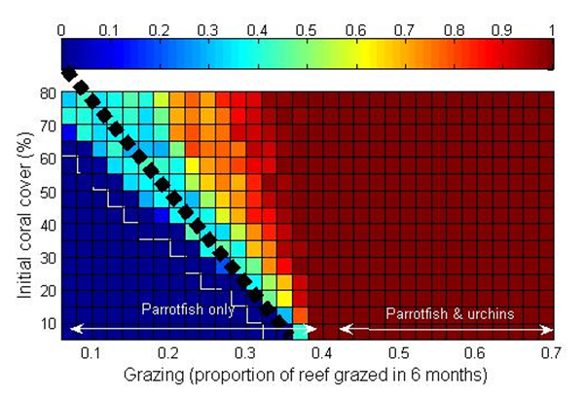
Carbonate budget model

Slide 29
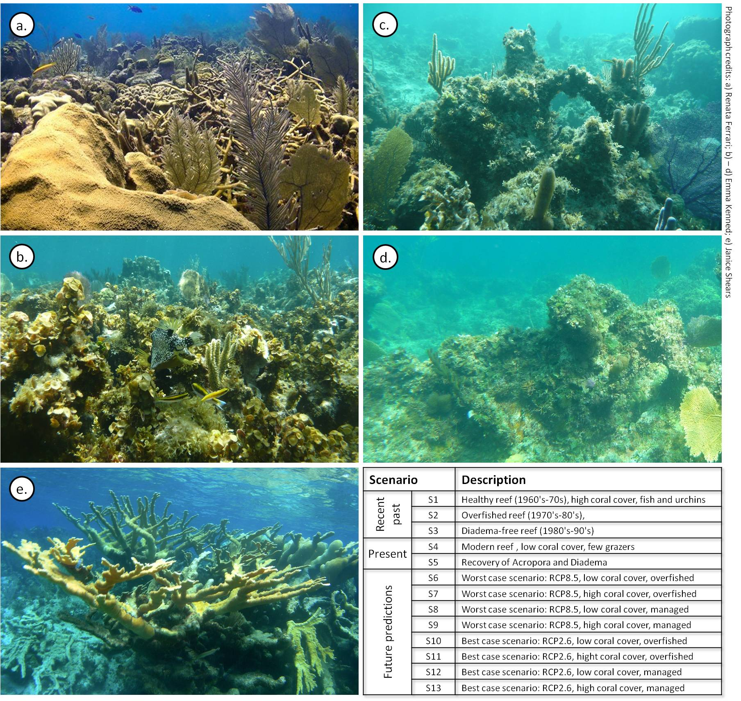




Model validation – and historical hindcasting
Tested against 3 real life reefs
  Jamaica (long time series)
Hindcasted based on 4 major reef types – have buidgets changed over the last 50 years?
Sensitivity analyses
S1
S2
S3
S4
S5
Healthy reef
Fished reef
Diadema-free reef
Modern reef
Recovering reef
High (55 ±5% coral cover
Unfished
Optimal environmental conditions
High (30%) coral cover
Fished community structure; reduced biomass
Increased urchins
Low (15%) coral cover
Fished fish
Low Diadema
Nutrification
Low (10%) coral cover
Low fish
Low urchins
Reduced Ω_{arag}
Increased Acropora
Increased urchins
Scenarios used to drive the historical model
Parameters populated by means and variance from published and unpublished sources
Notes:
Model can be applied to any reef system, so first thing was validate the model by inputting data from reefs we knew to see if we got the same output. Three Caribbean reefs –
Plot of mean carbonate budget generates (and standard error bars) for S1-S5. Based on 200 model runs. b) Image from Alvarez-Filip et al. 2009, showing changes in reef rugosity across the Caribbean from 1969 to 2008. Red line represents the best fitting model. c) Reproduction of plot a) overlaid with Caribbean rugosity data curve, demonstrates consistency between carbonate budget model estimates and observed Caribbean-wide rugosity loss. d) Summary of historical scenario outputs (based on 200 model runs). Each value is in kg of CaCO₃ deposited annually per m² planar reef area

Slide 30
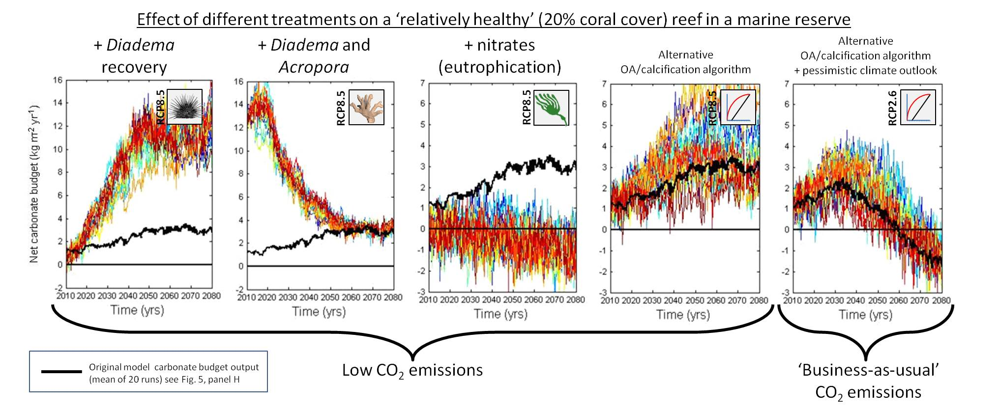
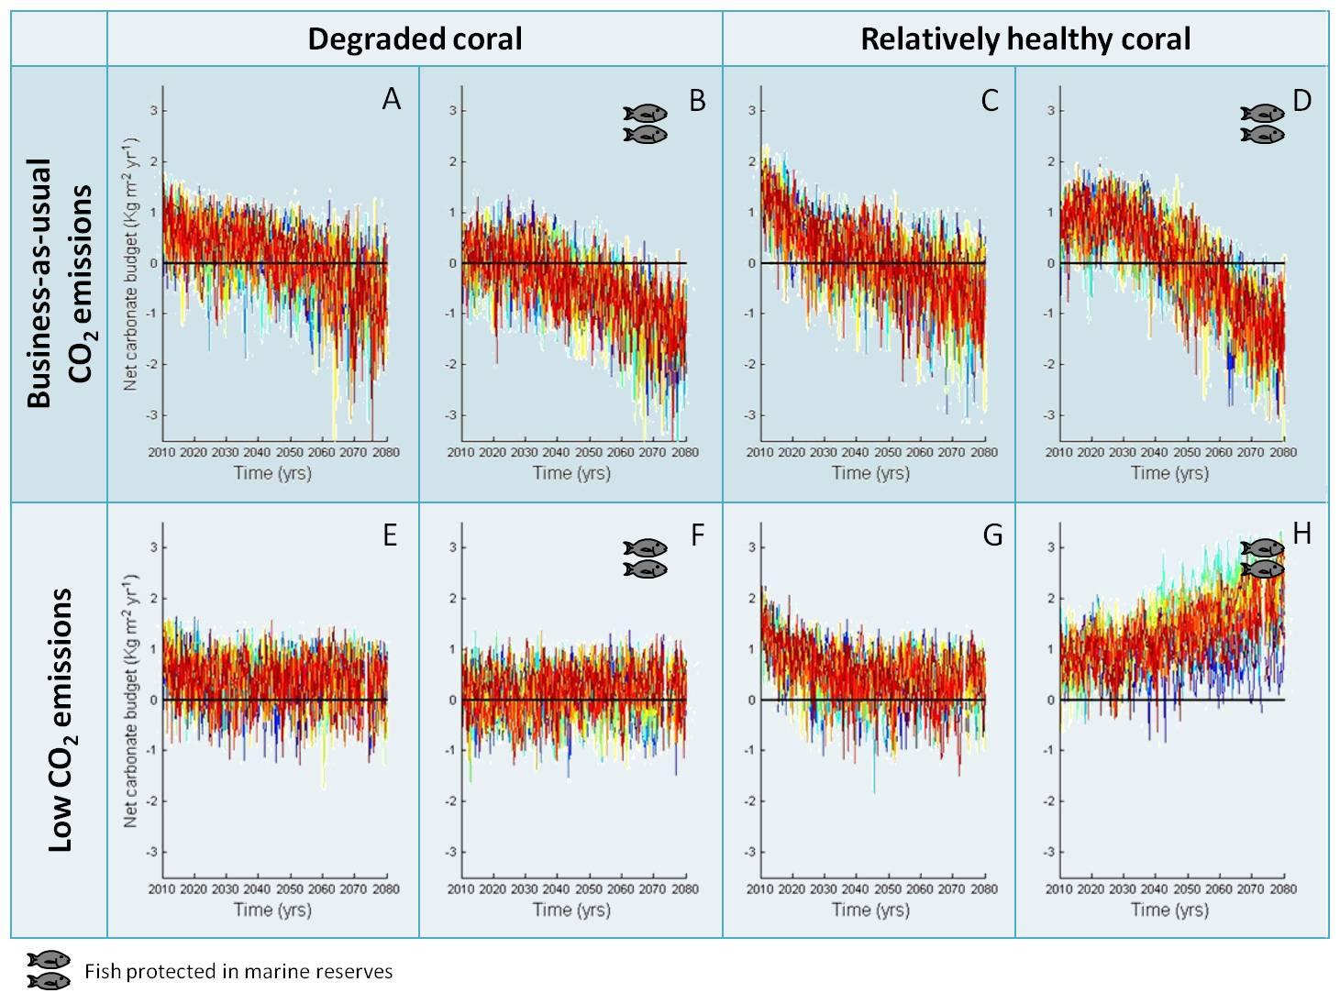

Slide 31
A calcium carbonate reef framework…
Reefs: characterised by 3D structure
CaCO₃ framework – architectural complexity
Provides ecological goods and services
  Biodiversity (e.g. fishing valued at $US 295 million)
  Coastal protection ($US 0.94-2.8 billion)
  Sand production ($US 2.7 billion)
Anthropogenic change
  Coral bleaching
  Ocean acidification
  Hurricane damage
  Algal blooms
  Coral disease
  Sedimentation
  Invasive species
  Diadema loss
Carbonate budgets
Alvarez-Filip et al. 2009
Structural complexity
of Caribbean reefs
Notes:
Thanks for introducing me, my name is Emma, I’m a final year PhD from the University of Exeter. Today I’m going to be talking about an aspect of my project that looks at modelling carbonate budgets of Caribbean reefs.
I’d like to start by putting my work in context:
CLICK: Reefs are characterised by their 3-dimensional architectural complexity: the word reef itself is a term for a structure that potentially causes a shipwreck hazard…
CLICK: …in the case of coral reefs this structure is a calcium carbonate framework created by biological and geological processes.
CLICK: The creation of this structural framework STRUCTURE provides important habitat that supports the highest diversity of organisms per m2 in the marine environment – this includes commercial fish worth up to $395 million)
Framework also provides other ecosystem services, such as Coastal protection – valued at up to 2.8 billion dollars in the Caribbean
And production of those white beaches are worth $2.7 billion… much of the value of reefs is derived from their three dimensional complexity.
CLICK: Ecological state of Caribbean reefs has deteriorated over the last 50 years, with many reefs that once looked like (top picture) now looking like (this) or even (this).
We’re well aware of the proximate drivers of reef change, which have caused many reefs, that once looked like this, to lose important structure and living coral cover/
A carbonate budget is a more holistic approach to measuring reef health, than traditional measures such as quantification of alagl or coral cover – as it takes into account important processes occuring beneath the surface of the reef. I wanted to explore changes in Caribbean reefs in terms of carbonate budgets.
Structural aspect of reefs also ecosystem services – such as coastal protection
Reefs are defined by their 3-dimensional structure – word reef actually means structure – made up of Calcium carbonate precipitated out of the seawater.
Associated with various ecosystem services
Antropogenic drivers mean reefs undergoing change. Anthropogenic and environmental factors are driving major ecological transitions on coral reefs

Slide 32
Why do we care?
Drivers:
  Coral bleaching
  Ocean acidification
  Hurricane damage
  Algal blooms
  Coral disease
  Sedimentation
  Invasive species
  Diadema loss
Caribbean reefs are changing
One aspect of this change is loss of architectural complexity
  Biodiversity (e.g. fishing valued at $US 295 million)
  Coastal protection ($US 0.94-2.8 billion)
  Sand production ($US 2.7 billion)
Carbonate budgets provide a useful proxy for reef health
  go beyond simple coral/ macroalgal cover metrics
Structural complexity
of Caribbean reefs
Alvarez-Filip et al. 2009
Reaka-Kudla, 1972. in Biodiversity II
Moberg & Folke, 1999. Ecological Economics
Burke et al., 2011. in Reefs at Risk
FORCE project www.force-project.eu
Notes:
Why are we interested in carbonate budgets?
The ecological state of Caribbean reefs has deteriorated over the last 50 years.
We’re aware of the main proximate drivers of this changes, which have caused many reefs that once looked like...this, to look bottom panel.
One aspect of this change is loss of architectural complexity...
Reefs have lost structure over the last 50 years –
Structure is associated with various ecological goods and services.
Examining carbonate budgets can help us explore this loss of structure.
In addition, carbonate budgets are a provide a useful tool for understanding the healthy functioning of a reef. They are a holistic health measure, as they take into account important bioerosive processes occuring below the surface of the reef – and so go beyond traditional measures of reef health such as looking at living coral cover and algal cover at the surface.

